Slide 1
Appliances energy prediction
R PROGRAMMING
Name : K.SivaTeja
Reg.no : 221FA14011
Branch : Bioinformatics
Section: A

Slide 2
Problem Statement
➢ To predict Appliance energy consumption for a house based on factors like temperature, humidity & pressure .
➢ In order to achieve this, we need to develop a supervised learning model using regression algorithms.

Slide 3
Reading the Data Set Data set has 19735 rows and 28 columns. The columns in data set have information as mentioned below : ● date : date in (yy-mm-dd) and time in (hr:min:sec) ● Appliances : energy use in Wh ● lights : energy use of light fixtures in the house, in Wh ● T1 : Temperature in kitchen area, in Celsius ● RH1 : Humidity in kitchen area, in % ● T2 : Temperature in living room area, in Celsius ● RH2 : Humidity in living room area, in ● T3 : Temperature in laundry room area

Slide 4
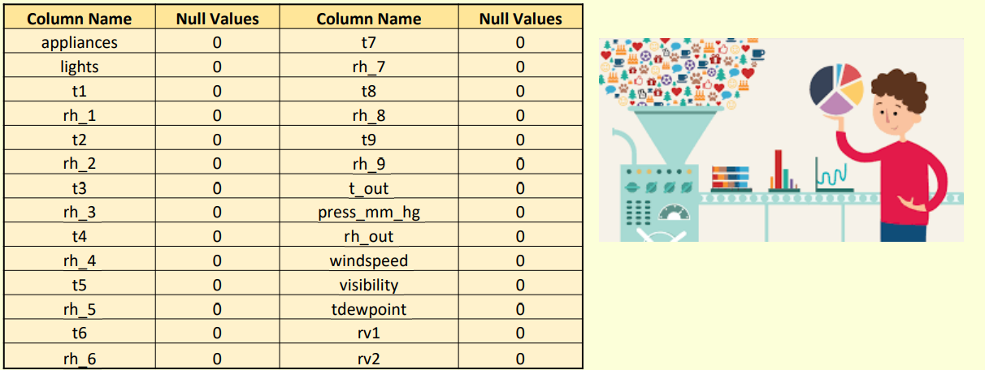
Data Cleaning ➢ Data set has no null values

Slide 5
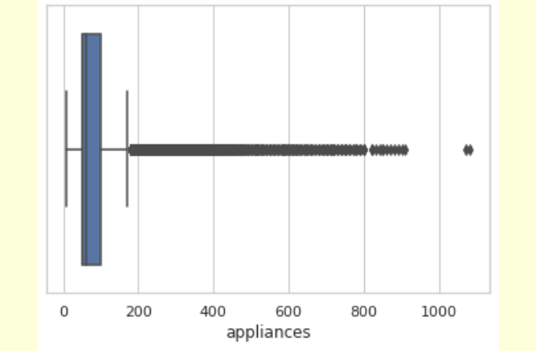
Dealing with Outliers
➢ Energy consumption of appliances cannot be negative and appliances having high energy consumption ( greater than 790 Wh ) are removed from data set.

Slide 6
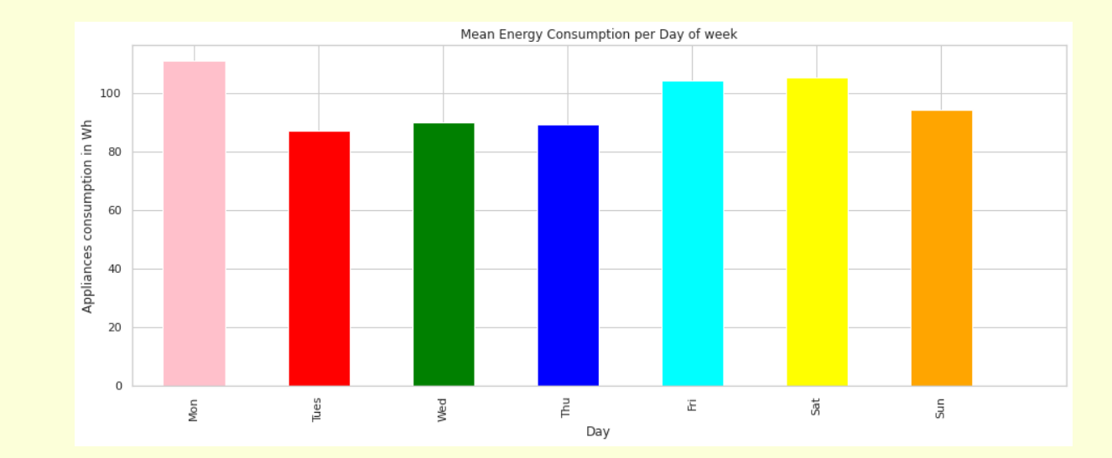

Slide 7
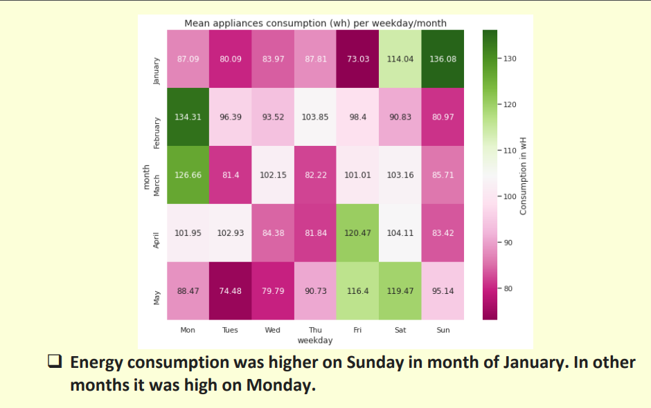

Slide 8
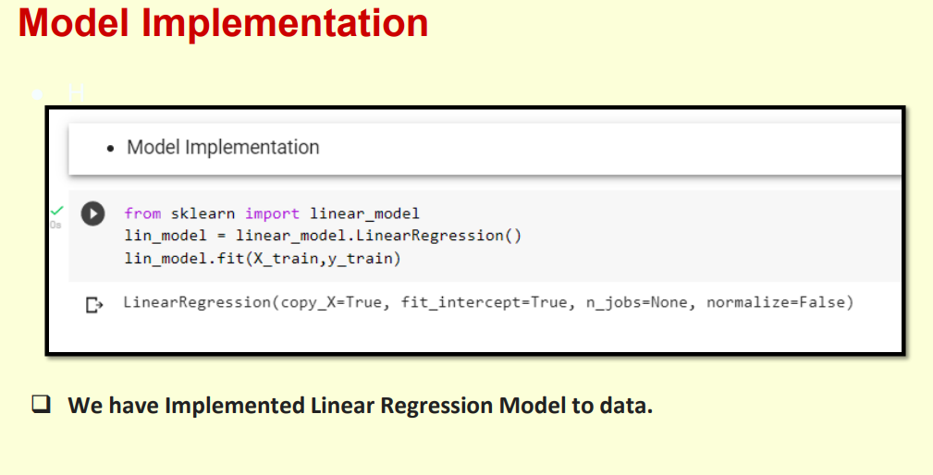

Slide 9
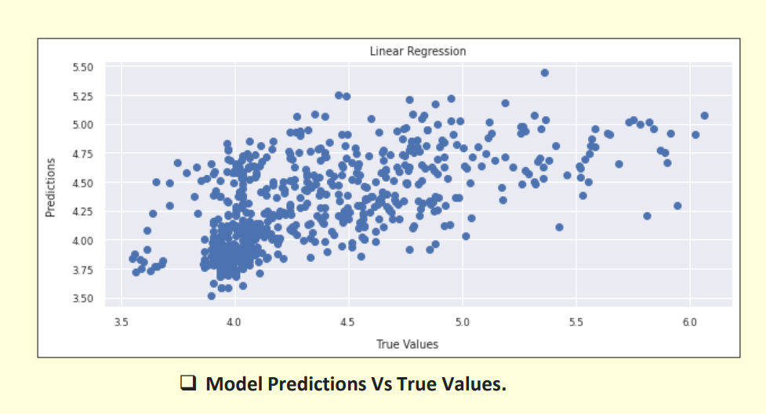

Slide 10
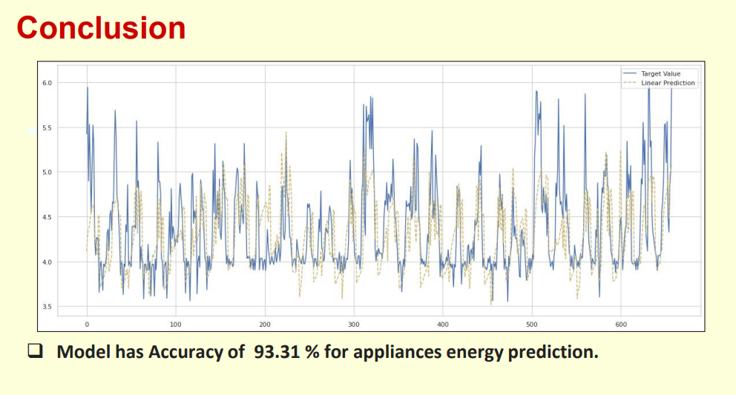

Slide 11
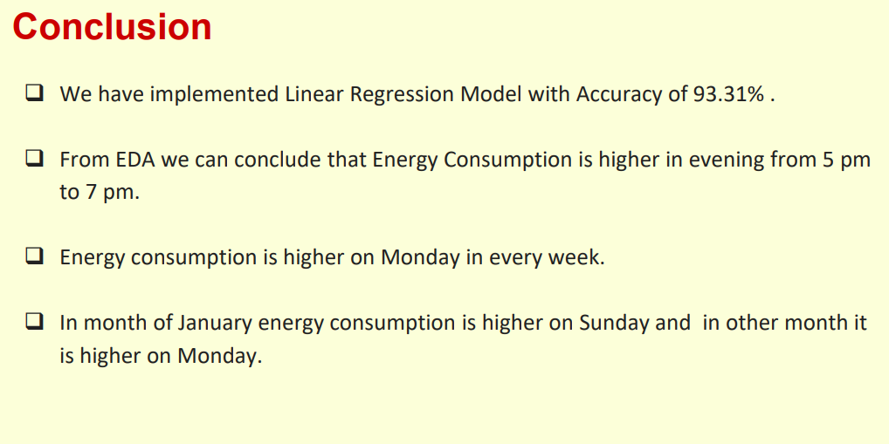

Slide 12
References
❑ Kaggle
❑ Youtube
❑ Github
❑ Towards data science
❑ Analytics Vidya
❑ Code basics
❑ Stack over flow

Slide 13
THANK YOU

